Slide 1
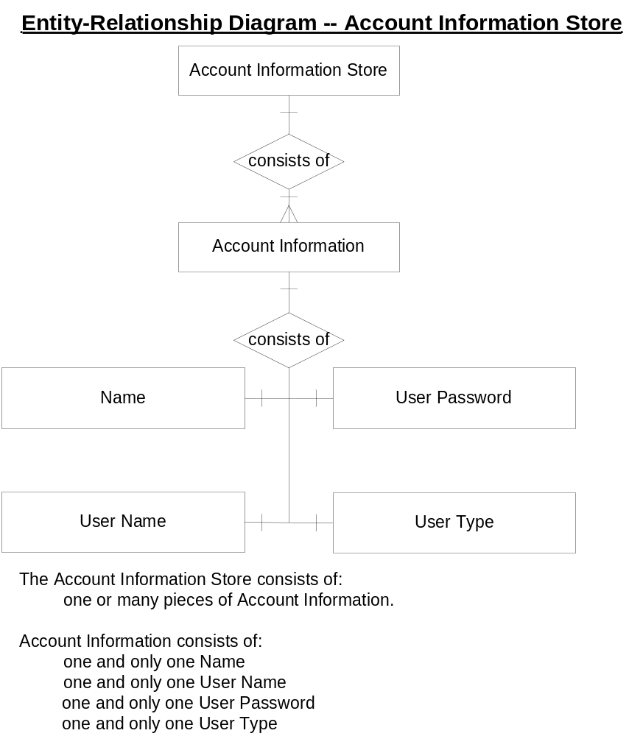
Given the following (partial) data model, interpret it as an appropriate Data Dictionary Entry

Slide 2
Data Dictionary Notation
Account Information = Name + User Name + User Password + User Type
Account Information Store = 1{Account Information}n
Name = First Name + Last Name +(Middle Initial)
User Name = *User’s account: 8 characters*
User Password = *String of characters: …*
User Type = *Indication of admin or cashier*

Slide 3
Data Dictionary Notation to ERD
Order Information = (Billing Address) + Order Date + Order Number + 1{Product Information}n

Slide 4
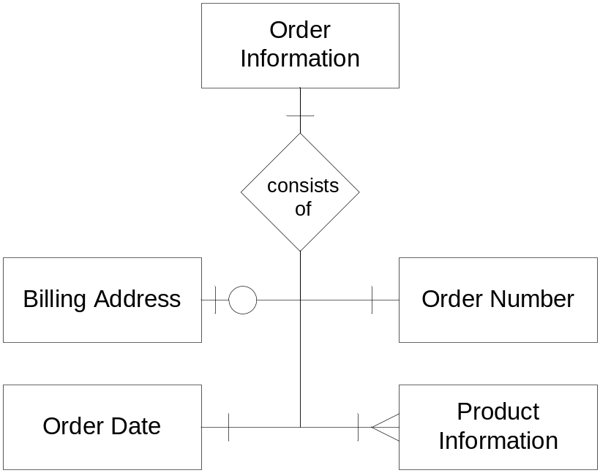
Order Information= (Billing Address) + Order Date + Order Number +
1{Product Information}n
Order Information consists of:
Zero or one Billing Address
One and only one Order Date
One and only one Order Number
One or many Product Information

